Slide 1


Health Insights
Diabetes Data Analysis & Interactive Dashboard
(A Data Visualization & Storytelling Project using Matplotlib, Seaborn, and Streamlit)
By AYUSHI SHARMA

Slide 2
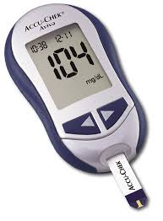
Introduction & Objectives
Project Overview
Diabetes is a chronic disease affecting millions globally.
Early detection and health insights can help save lives.
This project explores the Diabetes dataset through interactive visualizations to understand key health patterns.
Objectives:
Visualize key trends and distributions.
Spot and fix misleading charts.
Build an interactive Streamlit dashboard.
Present findings through clear, visual storytelling.

Slide 3
Methodology Overview
EXPLORATORY DATA ANALYSIS (EDA)
MISLEADING VISUALIZATION FIXES
DATA LOADING & CLEANING
DASHBOARD DEVELOPMENT
Imported CSV into Pandas, checked for missing values & outliers.
Used Matplotlib & Seaborn for histograms, boxplots, and heatmaps.
Explored relationships among Glucose, BMI, and Age.
Identified issues like truncated axes and corrected them for fair comparison.
Dashboard Development
Added filters for BMI, Glucose, and Age with real-time updates in Streamlit.

Slide 4
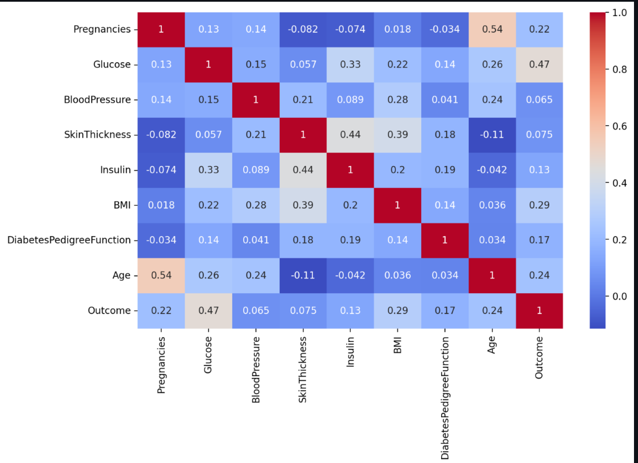
Key Insights
Higher Glucose levels strongly link to diabetes.
BMI is a major influencing factor.
Age shows higher risk among middle-aged and older adults.
Heatmap revealed strong feature correlations.
Dashboard enables focused exploration of specific groups.

Slide 5
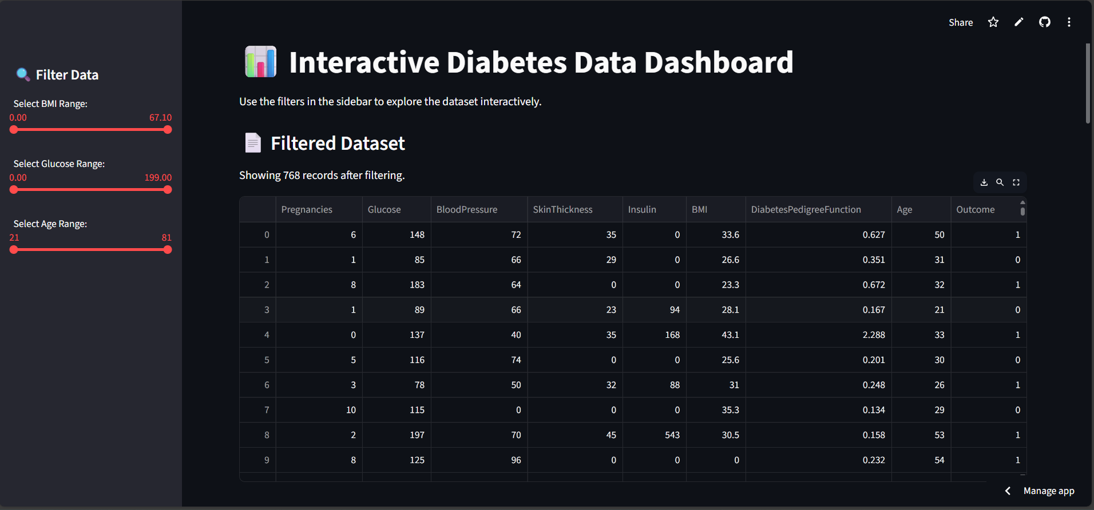
Streamlit Dashboard

Slide 6
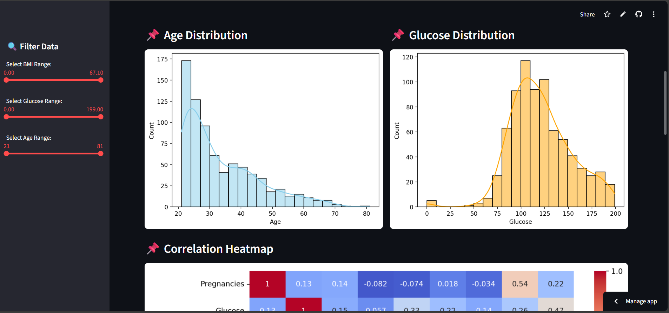

Slide 7

Conclusion
Built an interactive storytelling project using Python Libraries & Streamlit.
Improved data accuracy by fixing misleading visuals.
Dashboard simplifies exploring diabetes-related health trends.

